Slide 1
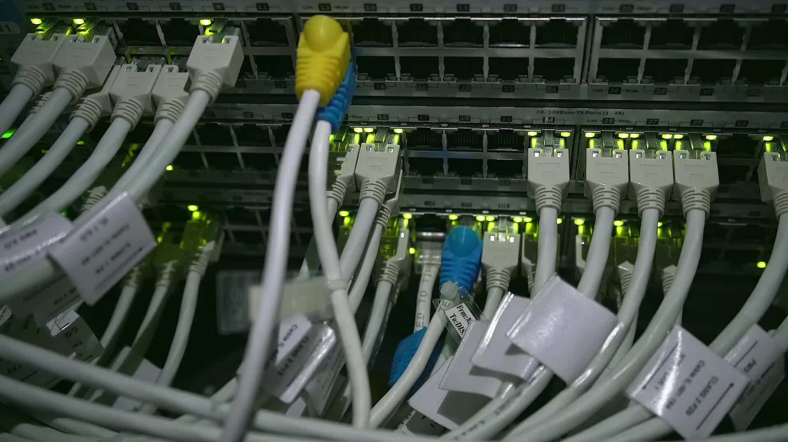
Implementation of Load Balancing in multi-controller topology
M. Alramadan 242344
M. Ali 249355

Slide 2
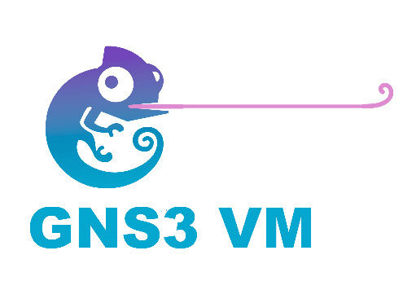
Environment
GNS3 will be used; alongside Docker.
Using Ryu Controller to implement the smart network.
Open vSwitch is used for connectivity between devices.

Slide 3

Algorithms Implementation
Load Balancing on level of control plane
Reliability in account (fails of one controller).
BW Reservation

Slide 4

By taking account two parameters:
Bandwidth of the links
Packet_in message rate
TCP Communication (Hello Messages)

Slide 5

Single point of Failure

Slide 6
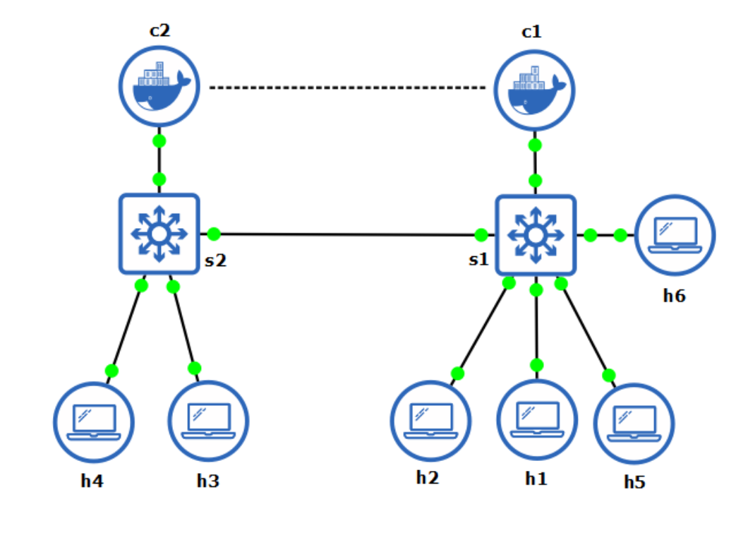
Problems
Problem: Single Point of Failure

Slide 7
Problems
Sync: TCP
Solved!
[c2:master, c1:slave]
[c2:slave, c1:master]

Slide 8
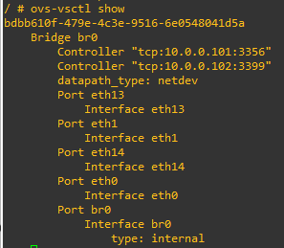
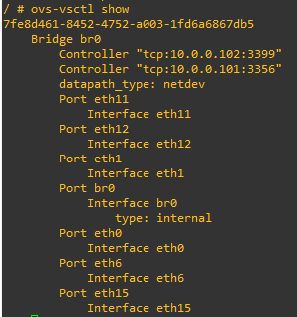
Switch_2
Switch_1

Slide 9
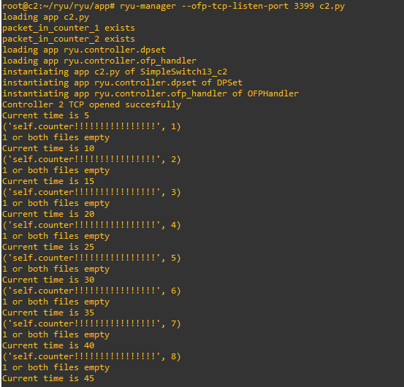
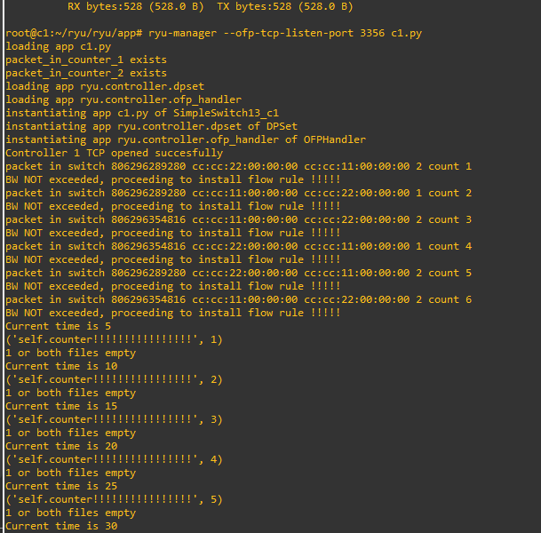
Controller_2
Controller_1

Slide 10
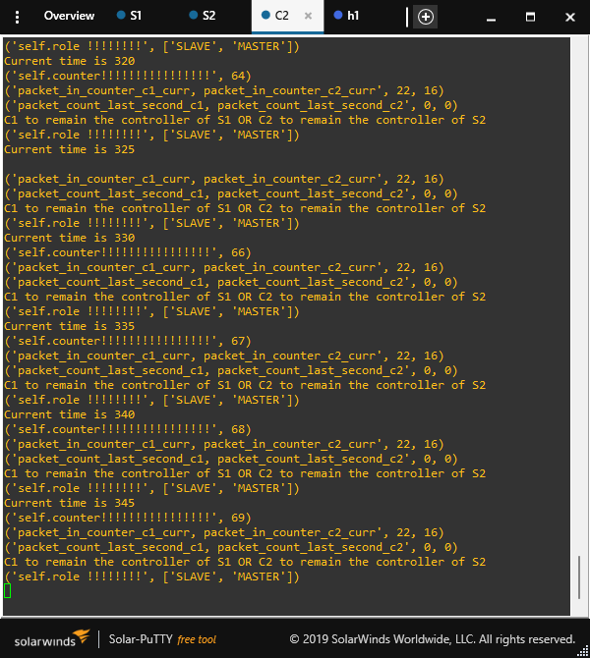
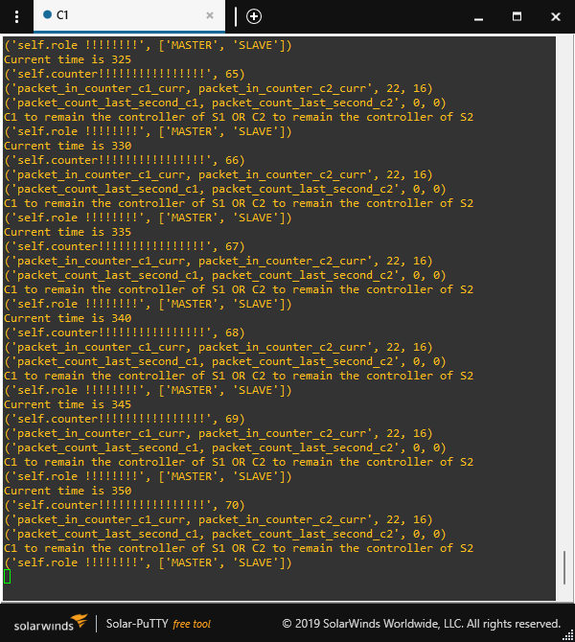

Slide 11
Problems
Sync: TCP
Single Failure
Point
[c2:master, c1:slave]

Slide 12
Problems
Hello?
Solved!

Slide 13
Problems
[master, master]
Solved!
[c2:slave, c1:master]
[c2:slave, c1:master]

Slide 14
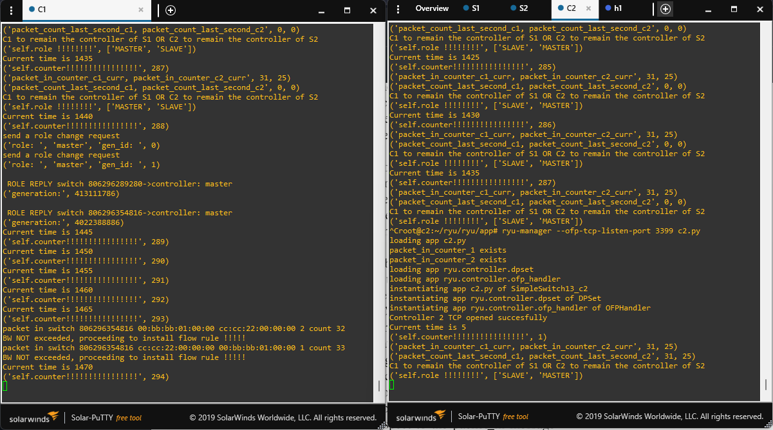
Kill Controller 2

Slide 15
Problems
[master, master]
Hello
[c2:slave, c1:master]
[c2:slave, c1:master]

Slide 16
Problems
[master, slave]
[slave, master]
Hello
[c2:master, c1:slave]
[c2:slave, c1:master]

Slide 17
Bandwidth Reservation Logic

Slide 18
Problems
[master, slave]
[slave, master]
Hello
[c2:master, c1:slave]
[c2:slave, c1:master]

Slide 19

Problems
[master, slave]
[slave, master]
Hello
?
[c2:master, c1:slave]
[c2:slave, c1:master]

Slide 20
Problems
[master, slave]
[slave, master]
Hello
[c2:master, c1:slave]
[c2:slave, c1:master]

Slide 21
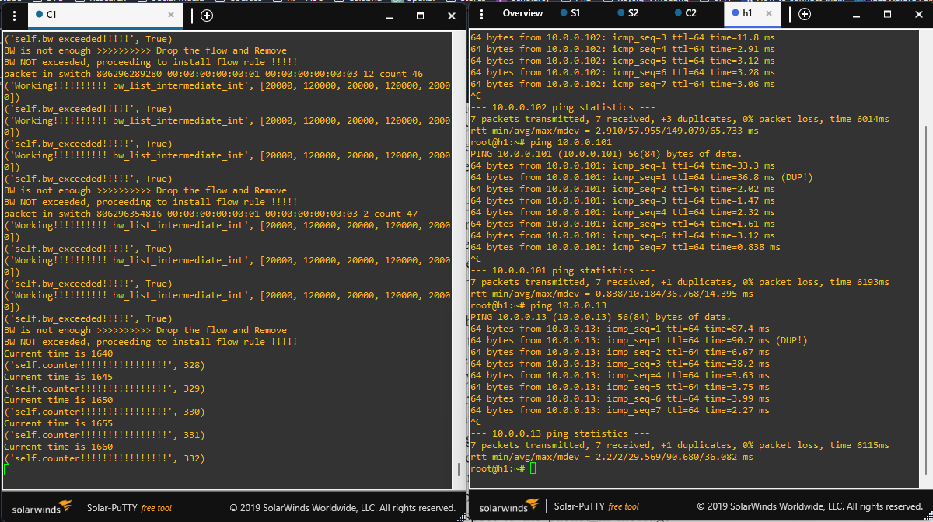

Slide 22
Load Balancing

Slide 23
Problems
[slave, master]
[c2:master, c1:slave]
[c2:slave, c1:master]

Slide 24

Problems

Slide 25

Problems
[master, master]
[slave, slave]
[c2:master, c1:slave]
[c2:master, c1:slave]

Slide 26
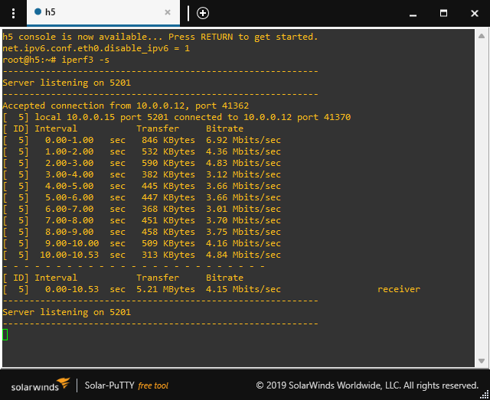
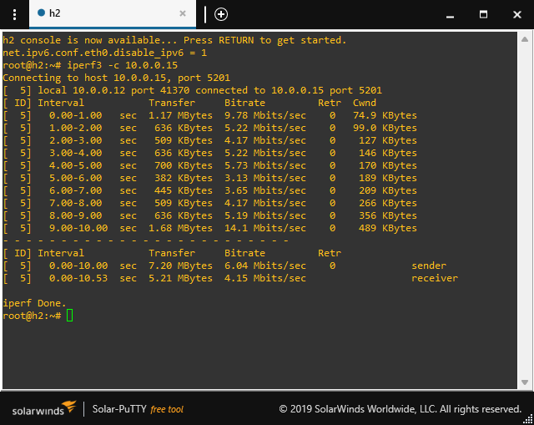

Slide 27
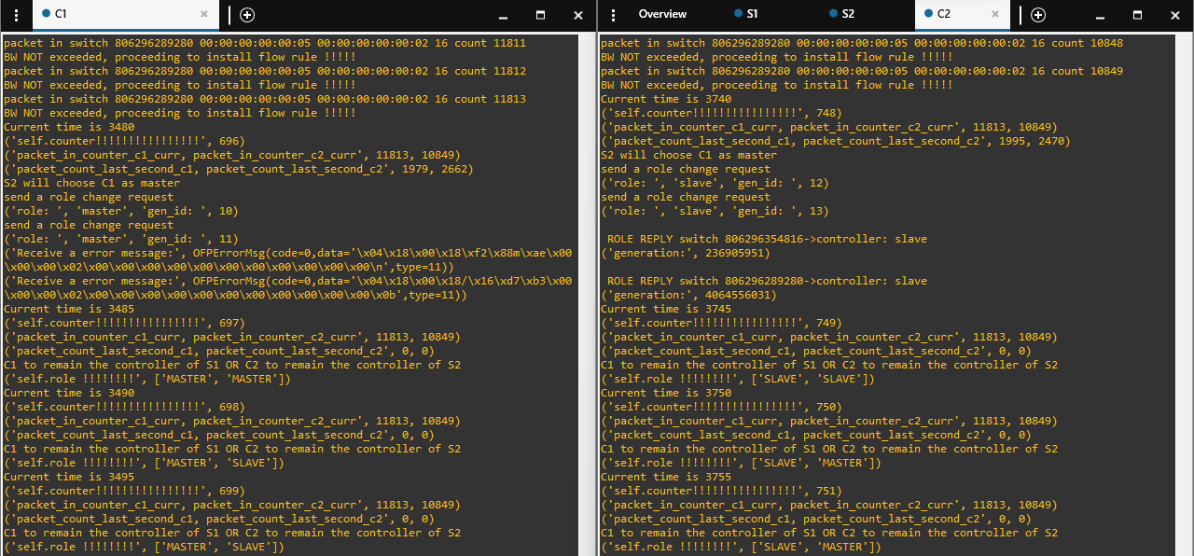

Slide 28

Thanks

